Slide 1
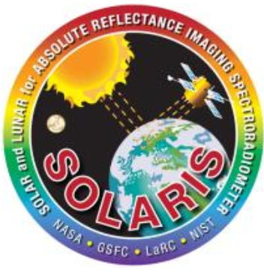
Solar and Lunar for Absolute Reflectance Imaging Spectroradiometer (SOLARIS)
Rachel Hetlyn, Boston University
August 1, 2012

Slide 2
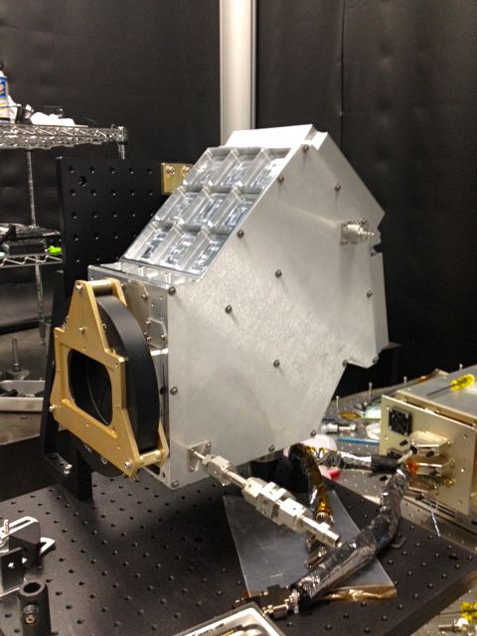
What is SOLARIS?
Climate Absolute Radiance and Refractivity Observatory (CLARREO)
Calibration Demonstrator System (CDS)
Thermal control of attenuators
Design and production of optics
Depolarizer technology
Notes:
As seen on the title page, SOLARIS stands for Solar and Lunar for Absolute Reflectance Imaging Spectroradiometer. It is an instrument that was developed for the Climate Absolute Radiance and Refractivity Observatory, or CLARREO. This was a proposed climate focused mission that would have the ability to produce highly accurate and trusted climate records while detecting climate trends and improving climate prediction models. SOLARIS is a Calibration Demonstrator System that exhibits thermal control of attenuators and the detector, design and production of optics, and depolarizer technology.

Slide 3
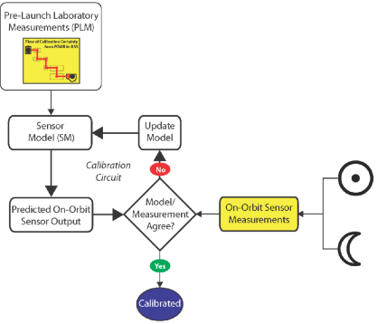
Objectives
Thermal control proven
Test prelaunch calibration methods
Spectral Irradiance and Radiance Calibrations Using Uniform Spheres (SIRCUS)
Analytical Spectral Device (ASD)
Transfer Radiometers
Notes:
The main objectives this summer were to prove that thermal control could be reached within the detector. It is important to have the detector as cold as possible to achieve the best measurements from SOLARIS. A second goal was to create a calibration method using SIRCUS in conjunction with an ASD. These calibration methods which I’ll describe later will be applied in the future to transfer radiometers to further calibrate SOLARIS.

Slide 4
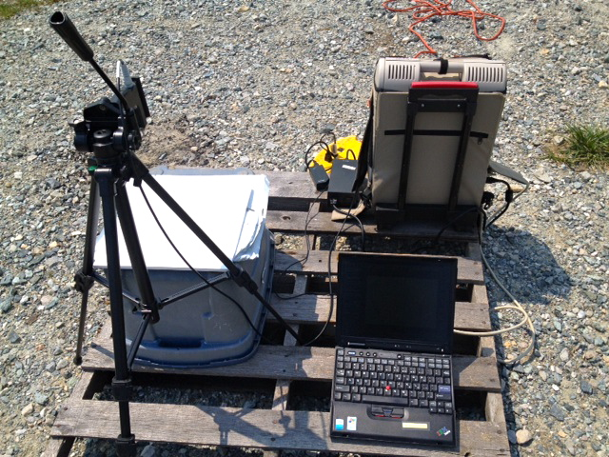
Analytical Spectral Device (ASD)
Field spectroradiometer
350-2500 nm
8°, 18°, and 25° FOV
Notes:
To help calibrate SOLARIS, I learned how to use an analytical spectral device, or an ASD. The instrument is a field spectroradiometer that has a resolution spectral range of 350-2500 nm to collect solar reflectance and radiance and irradiance measurements. The field of view can be changed, depending on what you are looking to obtain. Between measurements, a white panel is looked at measured for reference, shown in this picture here.
[Just for your benefit: The reflectance of the white panel is “known” (0.985 reflectance for 490nm, 0.986 for 500nm, etc..). This means that the reflectance of the vegetation (the other measurements) can be calculated similar how you found the calibration of the power meter. Refl_veg = (signal_veg / signal_panel) * refl_panel]

Slide 5
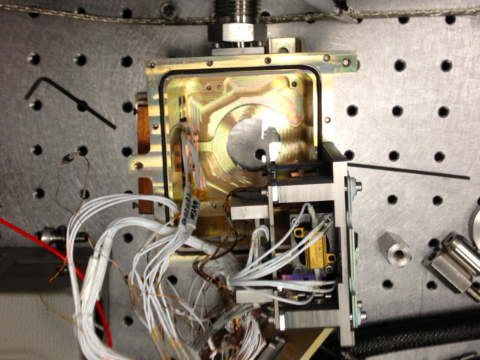
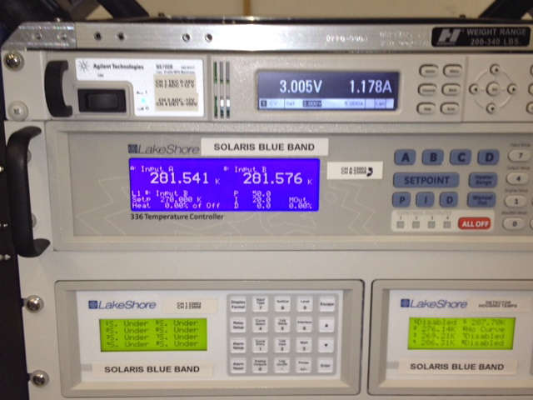
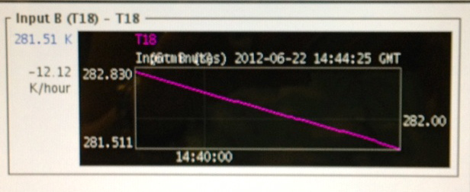
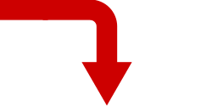
Thermoelectric Cooling (TEC)/ Detector Cooling
Notes:
A lot of what I have been working on in the past weeks has been detector cooling methods. This pictures shows the detector housing opened up. The cold casing is the housing. The white wires connect to platinum resistance thermometers or PRTs. There is a titanium stand in the bottom right that holds the detector. The copper piece on the right connects to the TEC (thermal electric cooler) to cool down the instrument. We want the instrument as cool as possible to reduce dark noise in our measurements. This machine controls the cooling. In the top, the voltage and current are increased. We’ve found that temperature flattens out around 9V and 4.5A. The bottom right graph shows the change in temperature over time. Decreases of about 20 K/hr or more are expected once voltage is increased. When the change in temperature decreases, it is time to increase the power. The unloaded TEC has gotten down to 173 K but when we did our measurement, D5 was 244K with everything connected.

Slide 6
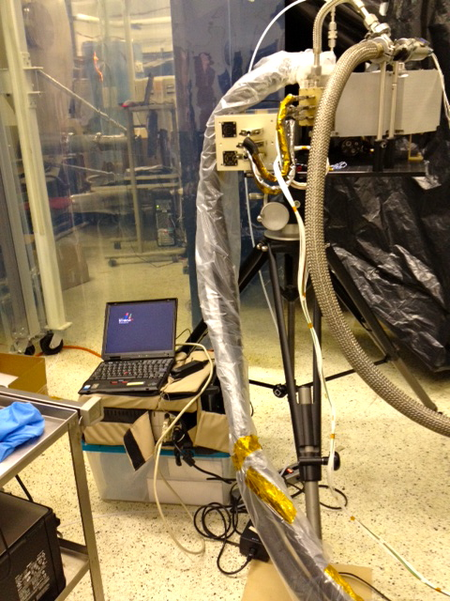
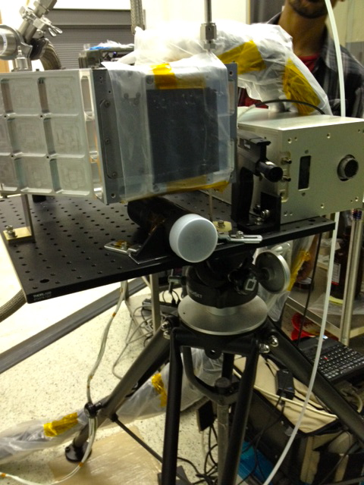
SOLARIS/SIRCUS Measurements
SOLARIS
Transfer radiometer
ASD foreoptic
Notes:
Here is the set up created for the measurements. The picture on the right shows SOLARIS with the detector attached and the ASD on the floor. The picture on the right shows the front view with a transfer radiometer underneath SOLARIS.

Slide 7
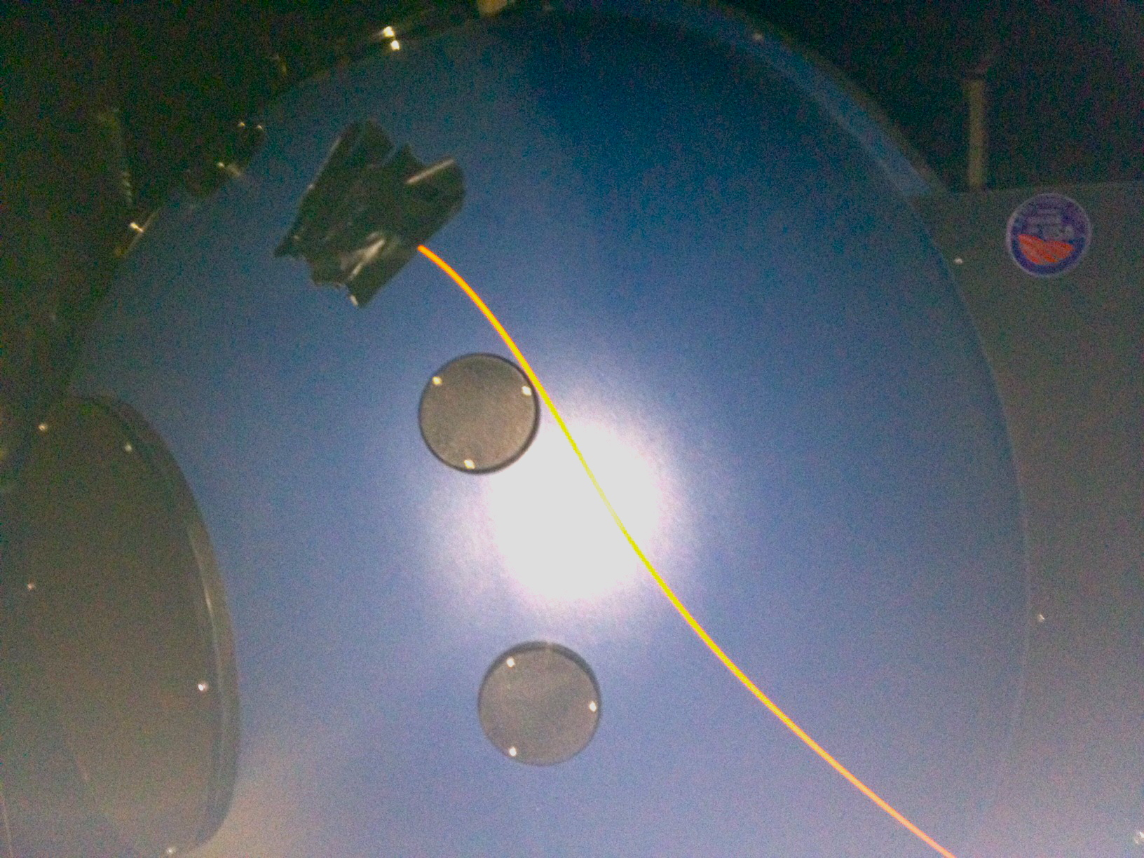
Integrating Sphere/SIRCUS
Spectral irradiance and radiance responsivity calibrations using uniform sources (SIRCUS)
Notes:
SOLARIS [and ASD, transfer radiometer were] was pointed towards this integrating sphere with this orange fiber optic cable from SIRCUS placed inside of it. SIRCUS is a NIST instrument that users tunable lasers coupled into the sphere as a spectral irradiance of radiance source. The sphere allows the laser light rays to be distributed to all points equally by multiple scattering reflections. The reason we use SIRCUS is to help with calibration. SIRCUS uses lasers which we know are a constant source of light measured at a particular frequency. By measuring these wavelengths with the radiometer, we can keep track of the current and compare it to the readings coming out from AOLARIS and the ASD. From here, we can use the measurements of SIRCUS to calibrate the instruments like SOLARIS by transferring the calibration from the transfer radiometer
[you transferred the calibration from ASD->power meter, where in the future we will transfer the calibration from the transfer radiometers->SOLARIS (or other satellite instrument)].

Slide 8
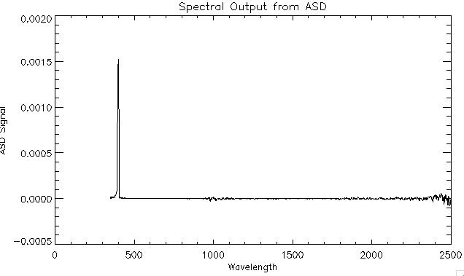
Results
λ = 398.73870 nm
S = 0.0016324742
Notes:
Here is an example of what sort of data the ASD obtains [when measuring SIRCUS, in this case SIRCUS was tuned to 400 nm]. This graph comes from one of our data files from measurements taken on June 22, 2012. [On that day we scanned SIRCUS from 400 to 450 nm in 1 nm steps]. Radiance is plotted against wavelength and by fitting a gaussian to the curve we can obtain the center wavelength and the peak radiance that that wavelength reaches.

Slide 9
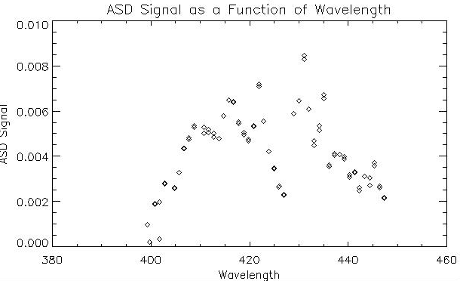
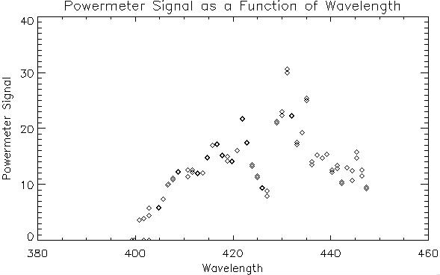
Results
Spectral Radiometric Calibration of the power meter using the ASD:
Notes:
Wavelengths from 400 to 450 nm were analyzed and the peak radiances were plotted against those wavelengths for the ASD as seen in the top left graph. Also, signal was taken from a power meter and was plotted against associated wavelengths. In order to do a full spectral radiometric calibration, we divide the radiance from the ASD with the signal from the power meter. If the two instruments are performing similarly, we expect a calibration model to produce a flat line. From these two plots, we can already identify similarities in the data collection from their similar curves.

Slide 10
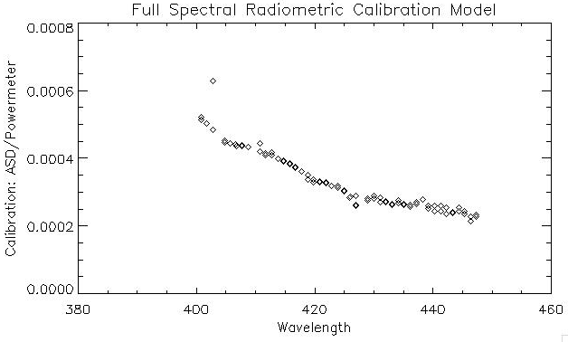
Results
Notes:
After doing the full spectral radiometric calibration, we see linear results meaning that the powermeter and ASD were operating similarly during our experiment. From this graph, we can find what calibration coefficient is associated with particular wavelengths and radiances.

Slide 11
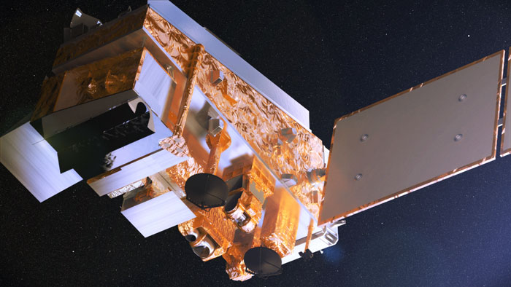
Discussion
Measure same source simultaneously with multiple instruments
Process data: find Radiance and center wavelength of SIRCUS
Find signal from both instruments
ASD gives spectral radiance
Power meter gives number related to amount of light it sees
Method developed here will be used for prelaunch calibration of satellite sensors like CLARREO
Relate the Power Meter signal to the radiance that ASD measured via calibration coefficient
Power meter now has calibrated output
Notes:
Transfer the calibration of one instrument to another instrument
ASD reports physical units of spectral radiance (W m^-2 sr^-1 μm^-1)
Power meter only reports a number related to the amount of light it ‘sees’
Transfer calibration: ASD -> Power meter
Measure the same source (SIRCUS) at the same time with both instruments
SIRCUS scans through the wavelength spectrum to characterize how the instruments behave for each color.
Now the Power Meter is on a known scale (with units of W m^-2 sr^-1 μm^-1) and this can be used to calibrate

Slide 12
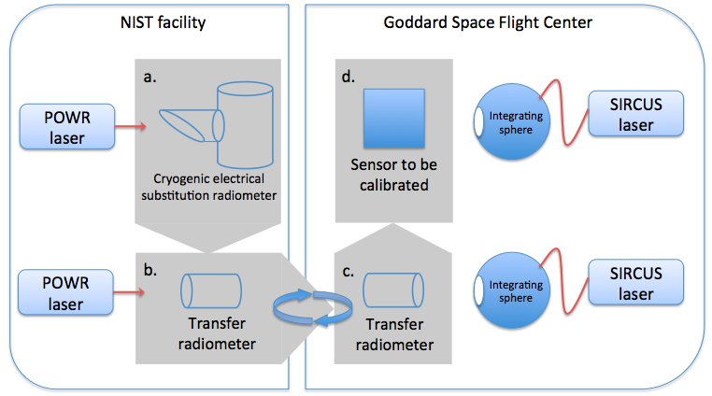
Discussion
Determine calibration
coefficient, “C”
Find ASD radiance from: L = S*C
Find λ from L
Eliminate ASD
ASD ≈ $70k
Powermeter ≈ $2k
Notes:
So why is this important? Once a calibration coefficient is determined, we can go back to our original formula and determine a radiance associated with a powermeter signal reading. Knowing the radiance, we also know the wavelength associated with that value. If we use the powermeter data with the calibration coefficient, we can eliminate the need for an ASD. Doing these calibrations is not only important to calibrate the instruments but to save money on missions. An ASD costs $72,000 where a power meter is only $2,000. If we understand the calibration coefficients from the power meter, using an ASD to calibrate instruments can be eliminated so mission budgets can be used more efficiently.
? Looking at the diagram in the top right, we can see how NIST and Goddard calibrate the laser and the transfer radiometers for the future satellite instruments. In the future we can transfer NIST’s standard Watt, the unit of optical power, to the satellite instrument via the transfer radiometer using the same method of calibration that we explored this summer with power meter and the ASD.

Slide 13
Solar and Lunar for Absolute Reflectance Imaging Spectroradiometer (SOLARIS)
Rachel Hetlyn, Boston University
August 1, 2012

